Slide 1
History – Pre-Ada
Colorado State University
Computer Science Department
Slides Originally Created by Albert Lionelle (Albert.Lionelle@colostate.edu)

Slide 2
How did it all start?
First Industry
First Computer
First Programmer

Slide 3
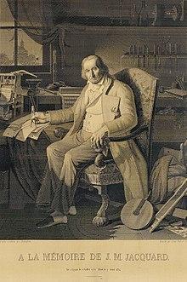
First Computer?
The industry - Weaving!
Jacquard loom / machine
Invented by Joseph Marie Jacquard in 1804
Cards set the patterns, colors, etc
Very specific use - not general purpose
“This portrait of Jacquard was woven in silk on a Jacquard loom and required 24,000 punched cards to create (1839). “ - ref: https://en.wikipedia.org/wiki/Jacquard_loom

Slide 4
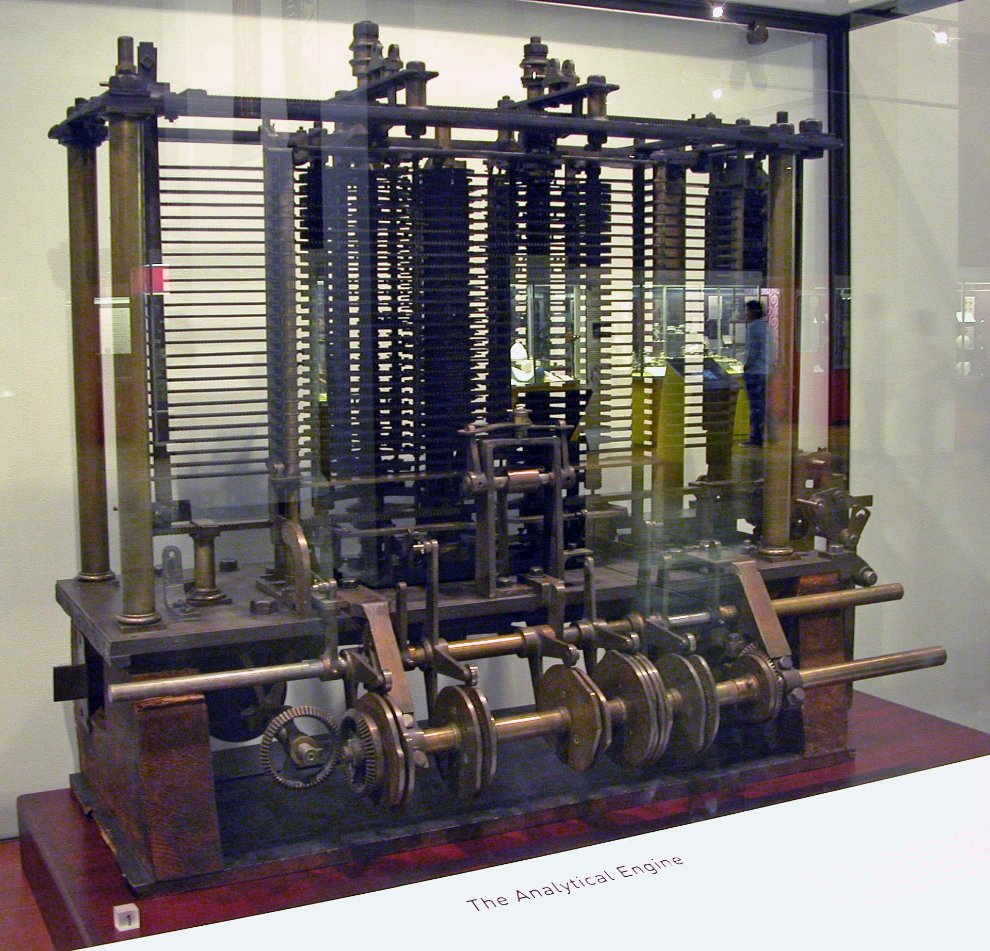
Analytical Engine
Charles Babbage
Polymath
“Father of the computer”
Mainly Theory
Purpose?
Algorithm Development and solving
1837
Bruno Barral (ByB) [CC BY-SA 2.5 (https://creativecommons.org/licenses/by-sa/2.5)], from Wikimedia Commons

Slide 5
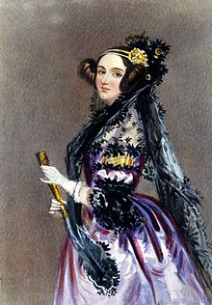
Enchantress of Numbers
She walks in beauty, like the night
Of cloudless climes and starry skies;
And all that’s best of dark and bright
Meet in her aspect and her eyes;
Thus mellowed to that tender light
Which heaven to gaudy day denies.
Excerpt from “She Walks in Beauty” by Lord Byron

Slide 6
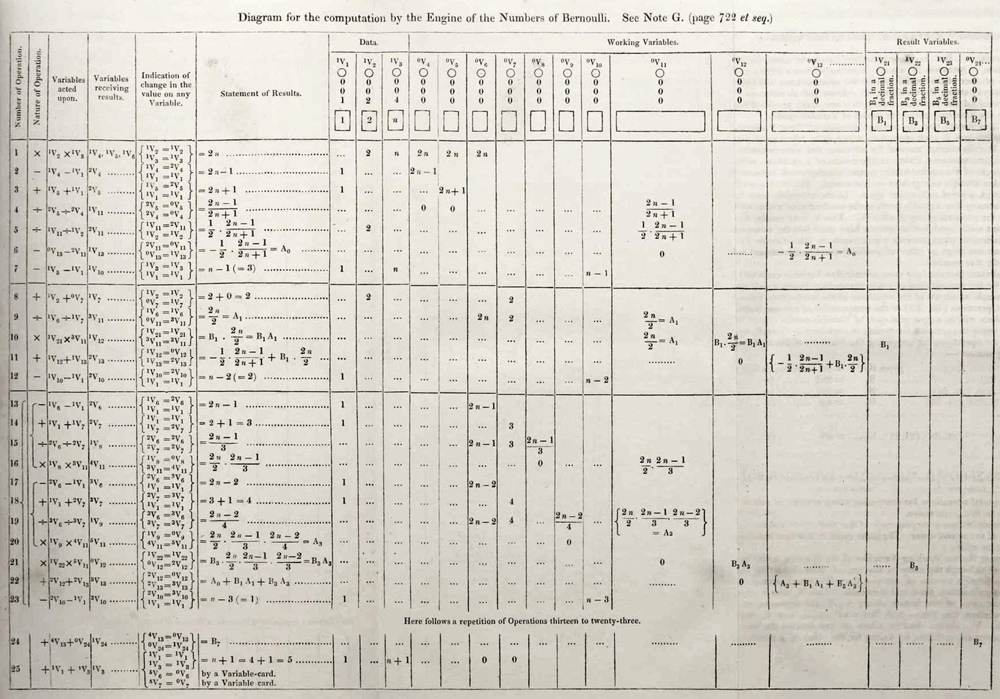
Ada Lovelace
Grew up in a rich but a single mother household
Father was the famous poet Lord Byron
Was known as a rebellious child and adult (non-conformist)
Mother insisted on her becoming a mathematician
She was unruly:
part artist
part scientist
part philosopher
Wrote the first “Computer Program”
Theorized computers could be ‘general purpose’ machines to solve complex problems.
By Ada Lovelace (http://www.sophiararebooks.com/pictures/3544a.jpg) [Public domain], via Wikimedia Commons
Additional Reading: Victorian computing visionary

